Slide 1




Risks & Issues
A risk is something that hasn't happened yet but has some probability of occurring. It is anything that could affect the delivery of the project e.g. timescales, scope, budget, achievement of objectives, benefit realisation.
An issue is essentially a risk that has now happened – a current problem or obstacle that will negatively impact the project.
Risks and Issues logs are tools for documenting any risks or issues and the actions to help mitigate / manage them.
Risks and issues log should be populated at the start of a project and reviewed and updated regularly. For large scale projects supported by the Improvement and Transformation team, risks and issues will be recorded on Verto.
Issues should have a record of the actions required to resolve them and who they have been assigned to.
Risks should be assessed in terms of their likelihood/probability of occurring versus the severity of the impact they will have if they occur. This will give you a risk rating score which will help indicate who should be informed. (See risk scoring matrix below for a large scale project as an example)
Project risks scored at 8 and above should be reported to Programme Board.
Project risks scored at 12 and above are reported by the Programme Board to the higher-level accountable board or forum.
Risks to report to the Programme Board at the discretion of the Project Group would include:
Lack of engagement (e.g. staff, service users, stakeholders)
Number of people impacted
Damage to organisation reputation
Identifying and recording risks and issues means that they can be assessed, mitigated and closely monitored to ensure that they do not adversely affect delivery of a project. This management of project risks and issues is critical to the success of a project.
Risks & Issues v1.0

Slide 2
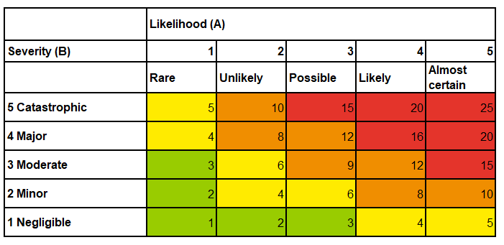
Risks & Issues
…continued
Controls and mitigation should also be recorded with any actions required to address the risk. The log provides the opportunity to re-score the risk once mitigating actions have been completed.
When writing a risk statement you must include the cause, the risk and the impact/consequence/effect.
Cause
Risk
Risk: By moving the xxx process completely on to SystmOne there is a risk that a large proportion of staff may require training to follow the new process therefore delaying the rollout of the system and the efficiencies identified as this has not been factored into the timeline for the project.
the so what (consequence/impact/effect)

